Slide 1


Slide 2


Slide 4

Accountability

Slide 5
Authenticity

Slide 6
Curiosity

Slide 7
You are Curious Too!

Slide 8


Slide 10
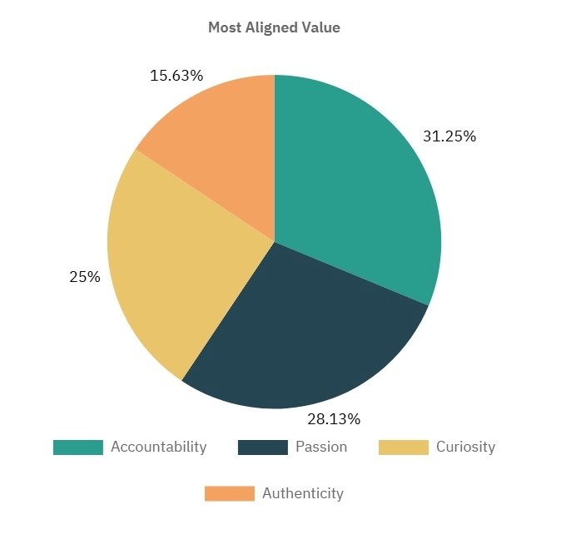
What value do you align yourself most with?

Slide 11
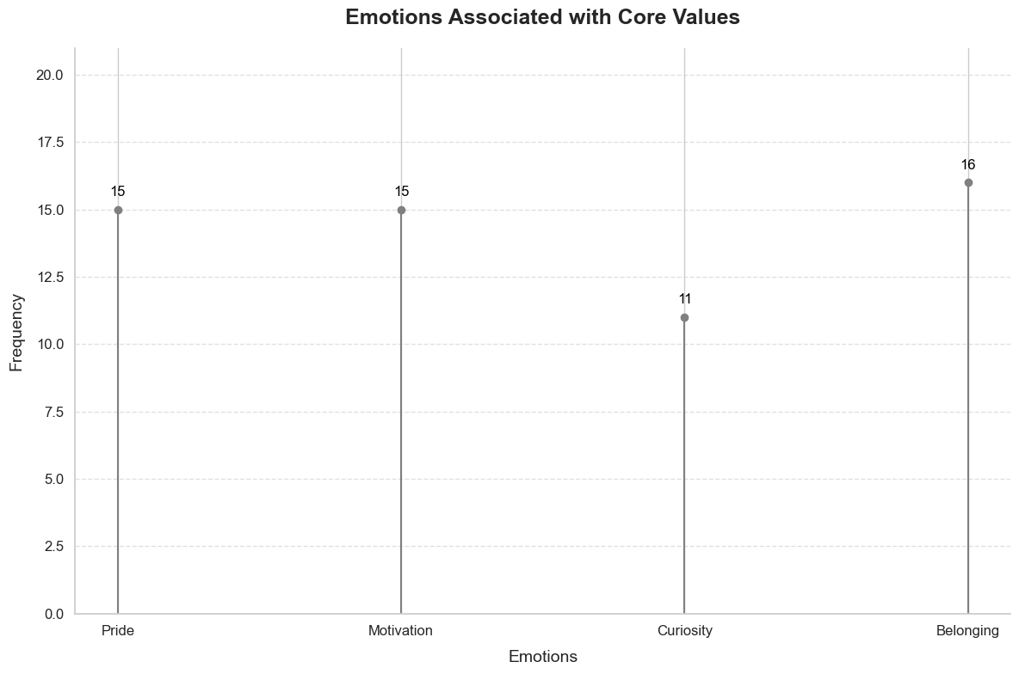
Which of these emotions do you feel in association with our core values

Slide 12
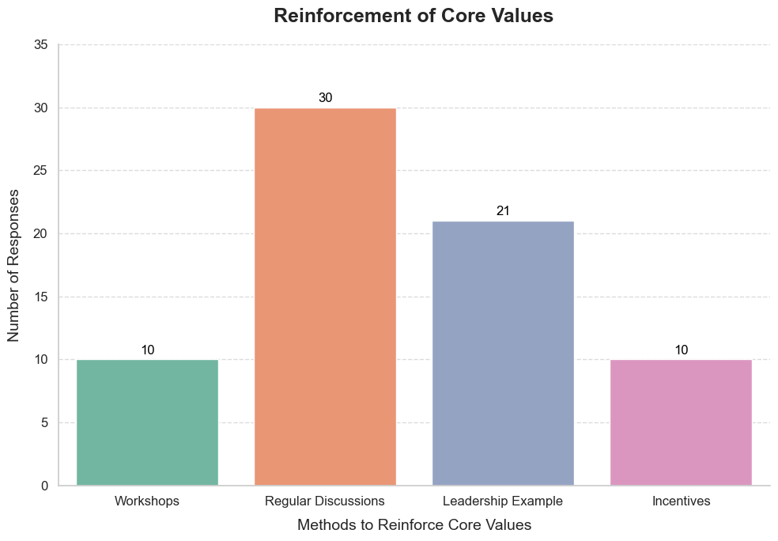
How can we reinforce our values?

Slide 13
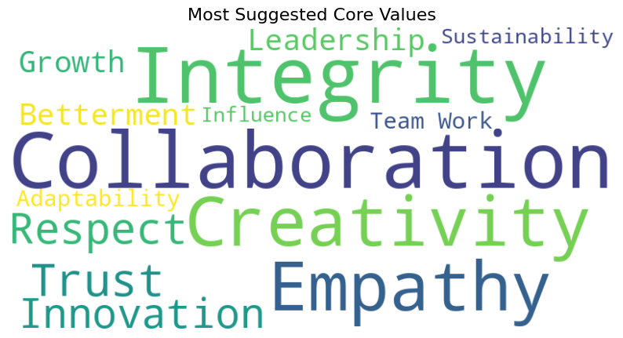
What is another value you would like to add?

Slide 15
Insights from our Interviews
Diverse Perspectives
Personal Stories

Slide 16
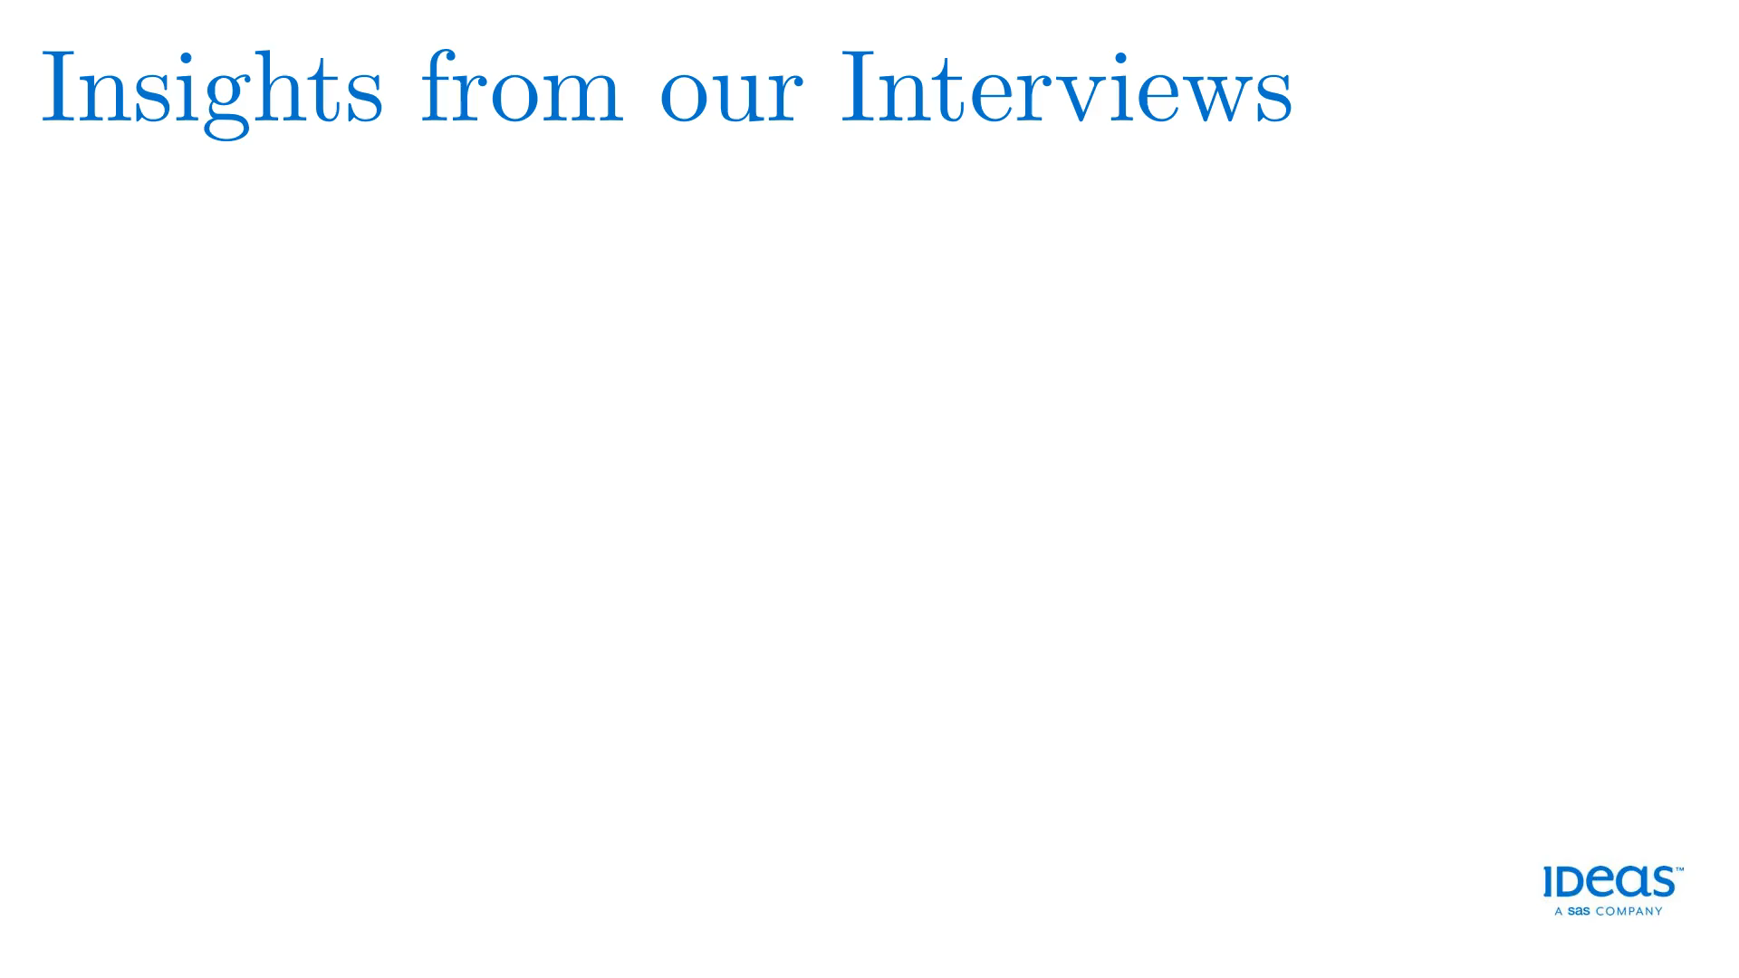
Insights from our Interviews
Shared Commitment
Our most Evident Value - Passion

Slide 17
Conclusion – What we learnt

